Slide 1
Camp Risk Management and Youth Protection Policies and Resources
4-H Virtual Brown Bag
May 1, 2018
Brian Oatman Risk & Safety Services

Slide 2
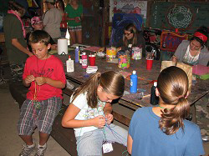
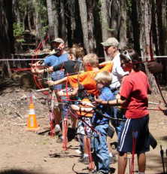
Introduction
Purpose of Camp Safety Project
Prevent injuries and illnesses
Comply with regulations/policy
Improve campers’ experience
2
Notes:
The 4-H State Office and ANR Controllers office asked us to work on camp safety about 10 years ago.
This was done to make sure you have the resources you need to plan for safety and comply with state regulations.

Slide 3
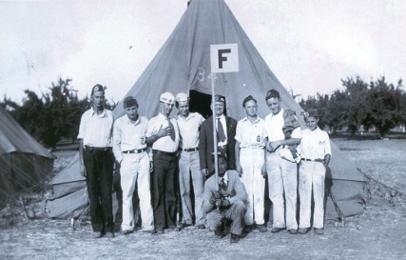
Organized Camp Regulations
Regulations enacted in 2008
Requirements include:
Preparation and submittal of documents:
Notice of Intent to Operate
Operating Procedures
Health Care Plan
Emergency Plan
Swimming & Boating Safety Plan
Vector Control Plan
Qualifications of camp personnel
3
Notes:
We also looked at regulatory requirements and ACA standards
When regulation came in 2008, state and local health officers recognized that it would take some time to comply, so did some training in 2008.
Very few inspections in first few years – with guidance on what was needed to comply
Some counties have developed programs for permits and inspections of camps
Note that these requirements apply to all “Organized camps” statewide
Other groups that operate camps – scouts, schools, churches, etc. need to comply – if a facility is operating a camp, they should already have most of this

Slide 4
Camp Safety Guidebook
Developed Camp Safety Guidebook to comply with Organized Camp Regulations
Training at semi-annual Camping Conference
Define roles (youth and adult volunteers)
Set standards for operation and supervision
Law requires 1 adult for every 10 youth
4-H guidance is 1 adult for every 6-8 youth
Template forms to comply with regulations
Use templates as example and modify to meet local needs and experience
4
Notes:
Reviewed law and other applicable standards (ACA)
Interacted with camping committee
Review with the Policy Advisory Committee and outside experts
Modified based on training and discussion
Recent updates to Camp Guidebook 2016, based on comments, input from Camping Committee and regulations
Plan to have enough supervision for camp
Consider smaller group activities, 2-deep, and emergency contingencies

Slide 5
Camp Safety Guidebook Overview
REGULATIONS, POLICIES, and BEST PRACTICES
This guidebook makes references to various laws, regulations, codes, policies, guidelines, and best practices. When reviewing the guidebook and applying the information, consider the following:
Laws, regulations, and codes are legally enforceable requirements and must be followed.
UC or 4-H policies are additional requirements that must be followed when conducting 4-H activities.
Failure to meet these required standards can result in fines, criminal charges, or increased liability against ANR, the county 4-H program, or individuals.
Guidelines or best practices are not enforceable regulatory requirements, but are measures that UC ANR management, in consultation with program staff and volunteers, has identified as recommendations for conducting 4-H activities.
Guidelines may be based on standards used by other similar organizations or as a result of experience in 4-H programs.
Failure to use guidelines or best practices in the operation of your camp may increase the likelihood of injury, illness, or liability.
Volunteer leaders should consult with the UCCE County Director and 4-H staff for local requirements.
5
Notes:
Guidelines were developed to promote safe and positive outcomes in 4-H activities..
Volunteer leaders should consult with the UCCE County Director and 4-H staff when planning camp and considering how the information in this guidebook applies to your specific situation.

Slide 6
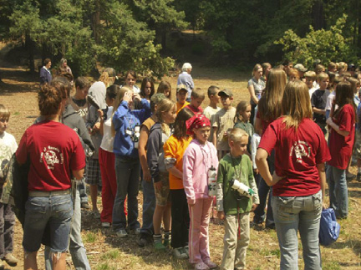
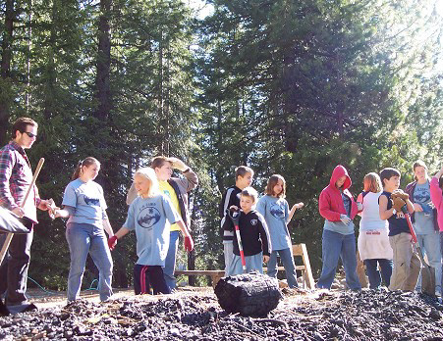
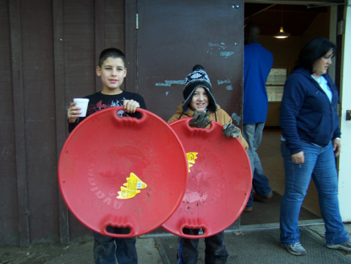
Camp Safety Guidebook Overview
Key Definitions and Terminology
Organized Camp: A site with a program and facilities that provides an outdoor group living experience for five or more days.
Site Operator: An individual or organization that owns, leases, or rents an Organized Camp.
Camp Director: Person responsible for daily decision making and supervision of camp program and staff.
Adult Volunteer (“Counselor”): Person directly involved with camp program activities and supervision and is at least 21 years old and has CPR/first aid training.
Regulations: one counselor for every 10 campers.
4-H Practice: one adult volunteer for every 6-8 campers.
Teen Counselor: 4-H term for high school age (14-18 years) youth leaders (also called junior counselors, teen staff, etc.)
6
Notes:
Note that 4-H Policy Advisory Committee determined that ALL 4-H camps would follow the Org Camp Reg – even when less than 5 days
Re: Adult/Counselor: Regulation says 18, but 4-H Policy says Chaperone must be 21 and Adults at camp are serving as Chaperones
Need to plan camp to ensure there is adequate supervision. Consider enough volunteers to accommodate small group activities, etc.
Working with Policy Advisory Committee to develop additional guidance for non-camp overnight events

Slide 7
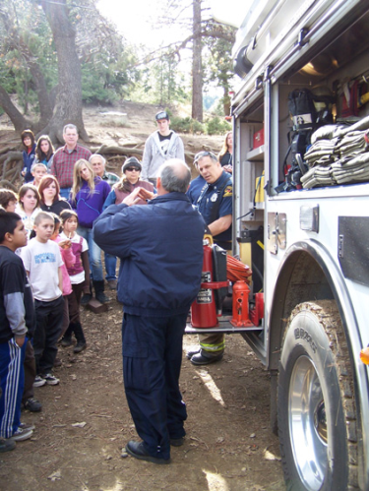
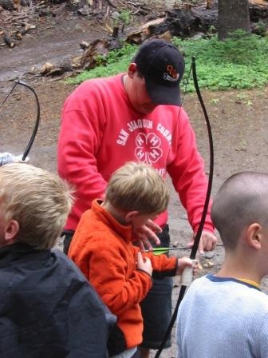
Camp Safety Guidebook Overview
Key Definitions and Terminology (cont.)
Health Supervisor: A person who is either a physician, registered nurse, licensed vocational nurse, or a person that has other specified health & safety training.
The Health Supervisor is responsible for developing Camp Health Care Plan and assessing, treating, and reporting injuries or illnesses.
Aquatics Supervisor: A person who provides supervision to the aquatic facility, staff, and program who is at least 18 years of age and who is certified as a lifeguard.
7
Notes:
Health Supervisor = nurse, EMT, etc. must have qualifications. If hiring, confirming certifications should be part of hiring process
Aquatic supervisor = Lifeguard – must be certified for appropriate water (pool vs open water)

Slide 8
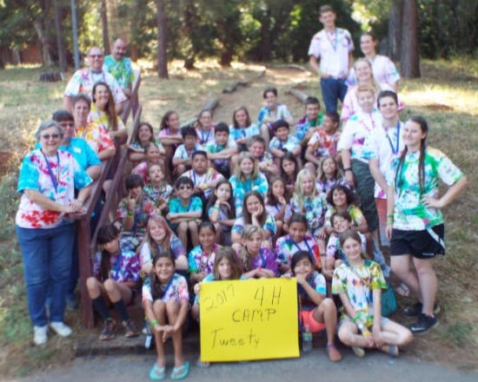
Camp Safety Guidebook Overview
Casual visitors are not allowed at camp
Everyone “at camp” should be a participant or have a role in the camp.
All adults at camp need to be appointed 4-H volunteers.
Appointed volunteers have completed screening, training, fingerprinting, etc.
8
Notes:
Exception: parents dropping off/picking up
Anything more than 1 hour is “at camp”
Reasons: Youth protection, Security, liability
Contact ANR Risk & Safety Services if clarification needed

Slide 9
Camp Safety Guidebook Overview
Camp Notification and Planning Documents
Note: All required submittals shall be transmitted to the local health officer (i.e. County Health Department).
Document | Responsibility
 | Site Operator | Camp Director
Annual Notice of Intent to Operate a camp (submitted to local Health Officer at least 30 days before camp) | X
Annual submittal of camp operating procedures or ACA accreditation to local Health Officer | X
Documentation of criminal background check for Director and adult volunteers submitted to local Health Officer |  | X
Camp Health Care Plan |  | X
Camp Emergency Plan, including evacuation procedures |  | X
Camp Swimming and Boating Safety Plan |  | X
Camp Vector Control Plan | X
9
Notes:
When we are renting a camp facility, some plans or documents would be completed by the site operator, and others would be specific to our camp program
For some camps, we are the operator, so are responsible for all plans
Staff should verify that we are meeting these requirements – work with your local camp committee or director
Overnight camps of 1-2 nights don’t need full plans and notifications, but should have some planning for emergencies.
Overnight camping at a public campground should have medical forms, evaluate hazards, identification of emergency procedures – see Clover Safe #29 Field Trip Safety

Slide 10
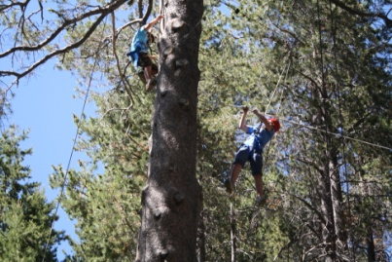
Using Plan Templates
How to use plan templates
Plan templates are designed to meet minimum regulatory requirements – there may be other safety issues that you should include for your camp.
If you already have developed a written plan, review it for compliance with Organized Camp Regulations.
If the campsite has a plan that you may adopt, review it to ensure that it works for your program, activities, and staff.
10
Notes:
Templates were developed to comply with the regulations.
You may need to add some sections to your existing plans and should consider site hazards, types of facilities/equipment, terrain, animals, procedures.

Slide 11
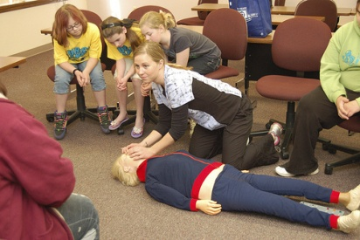
Camp Safety Guidebook Overview
Annual Inspections/Permits
Food Facility
Public Swimming Pool and Spa
Drinking Water System
County Camp Health & Safety Program (in some counties)
Licenses and Certifications
Lifeguard
Health Supervisor
Water Treatment/Distribution Operator
11
Notes:
When we rent a camp facility, they should have already completed permits and inspections
Camp Director and 4-H Staff should verify who is responsible and that these requirements are completed

Slide 12
Summary of 4-H Injuries
Types of injuries in 4-H (based on insurance claims submitted)
Avg. cost per claim = $2,700
Type of Injury/Illness | Number of Claims
Slip/Trip/Fall | 33
Animal | 29
Sports | 26
Illness | 15
Bite/Sting | 10
Struck by Object | 7
Cut/Puncture | 5
Tools | 3
Other | 5
Total Injury/Illness Claims | 133
12
Notes:
133 claims to 4-H accident-illness insurance in past 10 years (2006-2015).
Slip/Trip/Fall = Wrist, Ankle, Knee, Elbow, Leg, Hand, Back
Animal = 16 horse / 5 cow / 4 sheep / 2 pig / 2 not specified
Sports: Injuries
Playground
Capture the flag laceration
Tug of War fracture
Diving Board sprain
Snowboarding head injury
Skating
Ping Pong
Basketball
Football
Soccer
What can we do to prevent these types of injuries? Discuss

Slide 13
Incident Reports
Purpose: to document incidents for potential claims and to provide data for planning and prevention of future incidents.
Please complete UC ANR Incident Report form (http://ucanr.edu/incidentreport) as soon as possible.
Provide as much information as you can.
Submit report to your UCCE office.
ANR Staff should forward the report to ANR Risk Services.
13
Notes:
Reporting incidents helps us track trends
We can identify activities that are causing frequent injuries and look for root causes
We can provide guidance to help reduce injuries
We won’t be caught unaware of serious incidents
We will share data with statewide office

Slide 14
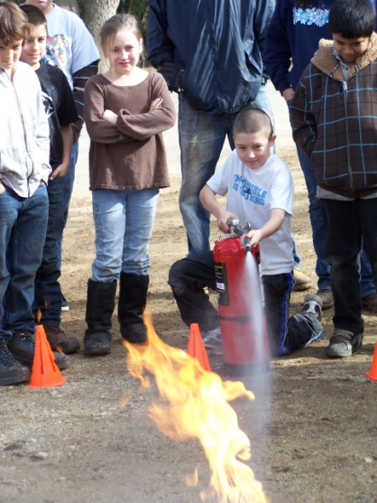
Camp Incidents in 2014-17
Summary of Incident Reports submitted to Risk Services
Reports range from minor first aid (heat illness, cuts, bee sting) to emergency medical (sprains/strains)
Type of Incident | 2014 | 2015 | 2016 | 2017
Medical | 11 | 17 | 7 | 8
Conduct | 4 | 3 | 0 | 0
Supervision | 1 | 0 | 0 | 0
14
Notes:
Take aways:
50% reduction in incident reports form previous 2-year period – less incidents or less reporting?
No incident reports for conduct or supervision issues – have these gone away or dropped below incident level?
If unsure – report. If concerned about sensitive information call Brian.
Ratios of medical issues are similar from year to year and match insurance claim ratios.

Slide 15
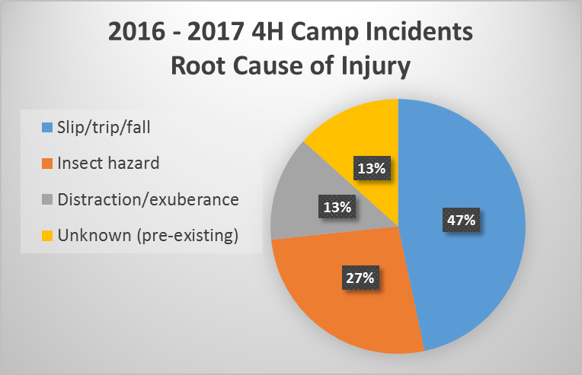
Camp Incidents in 2016-17
WHY did it happen?
15
Notes:
Take-aways
Looking at the “Why” or root cause of incidents can help us to see what percentage are preventable and to be prepared for what we can’t control
Slip/trip/fall – only one case of running.. Most were walking or not doing anything unusual.
Bee stings continue to be reported each cycle and often result in multiple injuries.
Distraction exuberance – expect and plan for this in running or very active games.
87% of the root causes could be addressed with site walk-through and planning. Not enough to do it once, but should be repeated each session. Consider all levels of mobility and awareness in walking paths and activity sites.
13% unknown possibly due to pre-existing conditions – some percentage of campers and volunteers will arrive with unknown or undisclosed pre-existing conditions. Can’t prevent or plan, but should have awareness and accommodation.
Big take home – your camp nurse is invaluable for response to incidents and injuries.

Slide 16
Incident Reports
16
Notes:
Example of form
Who, what, when, where, how
Witnesses or other involved parties
Medical or police reports
You may not have all the requested information – that is OK.
Put as much as you can and send in to your county office

Slide 17
Questions?
For More Information
UC ANR EH&S website:
http://ucanr.edu/4hcampsafety
UC ANR 4-H Camps website:
http://4h.ucanr.edu/Programs/Camps/
4-H Camp Risk Assessment Workbook (available at UCCE County Offices or EH&S website shown above)
Brian Oatman baoatman@ucanr.edu
530-750-1264
17

